Slide 1
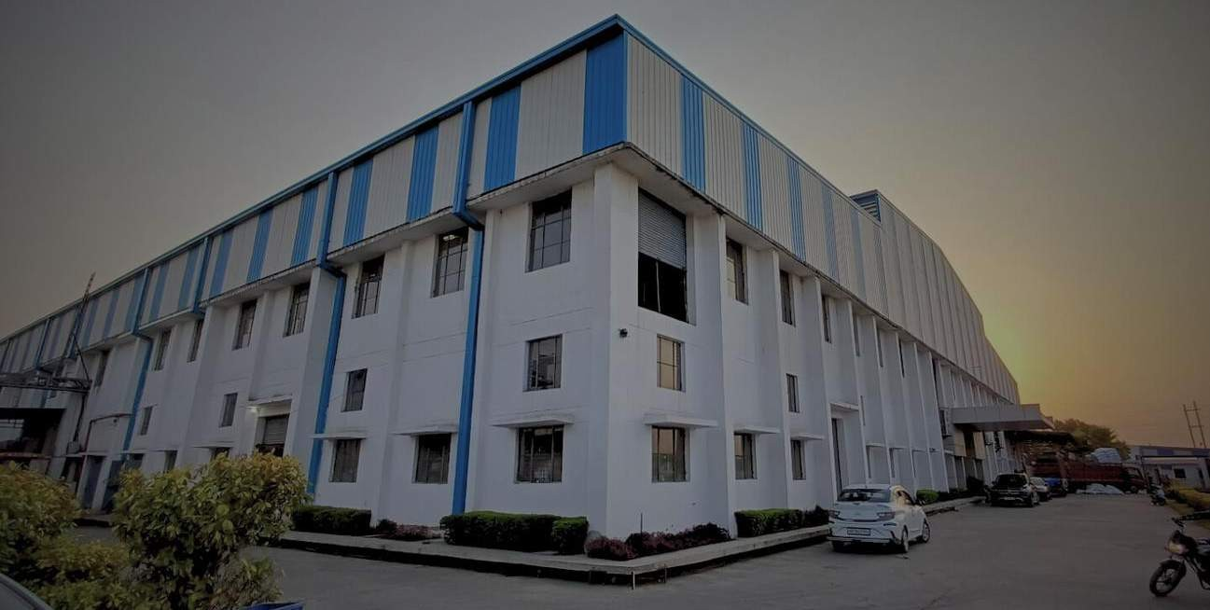
MILTARY BOOTS COLLECTION - 2024
LE MAK EXPORTS PVT LTD
64-B1 Co-Operative Industrial Area Dada Nagar, Kanpur 208022, India
L E M A K E X P O R T S P V T
Factory - 1
64-B1 Co-operative Industrial Area Dada Nagar, Kanpur 208022 kushal@lemakexports.com
L T D

Slide 2
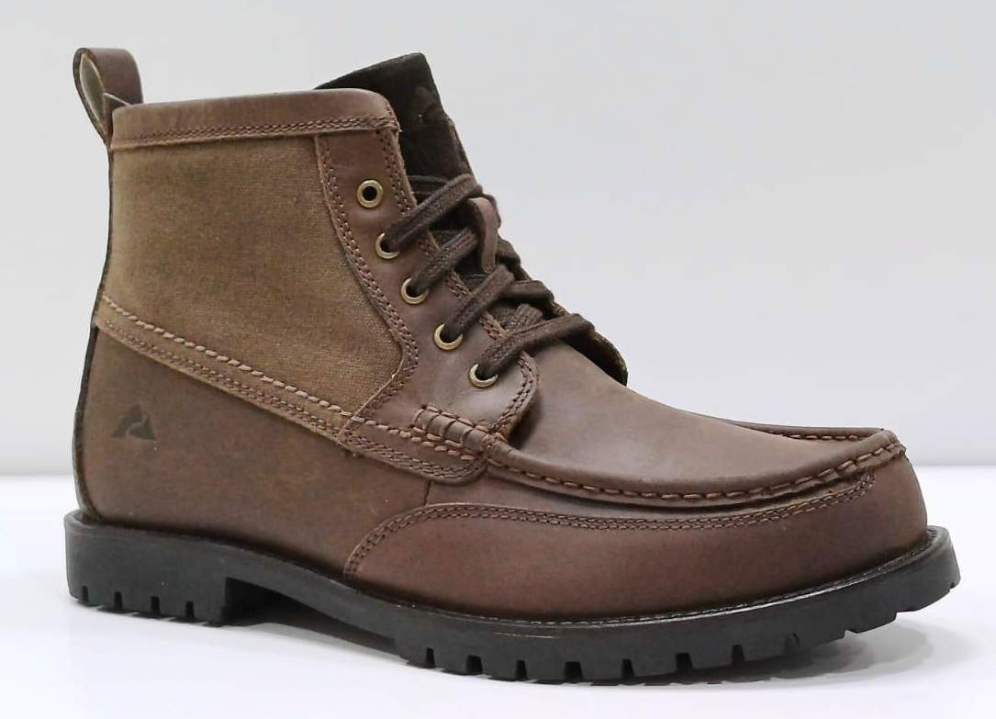
Model | LMM-10010
L E M A K E X P O R T S P V T
Factory - 1
64-B1 Co-operative Industrial Area Dada Nagar, Kanpur 208022 kushal@lemakexports.com
L T D

Slide 3
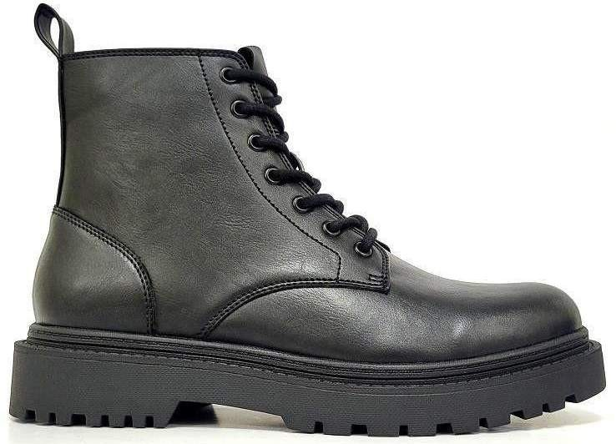
Model | LMM-10011
L E M A K E X P O R T S P V T
Factory - 1
64-B1 Co-operative Industrial Area Dada Nagar, Kanpur 208022 kushal@lemakexports.com
L T D

Slide 4
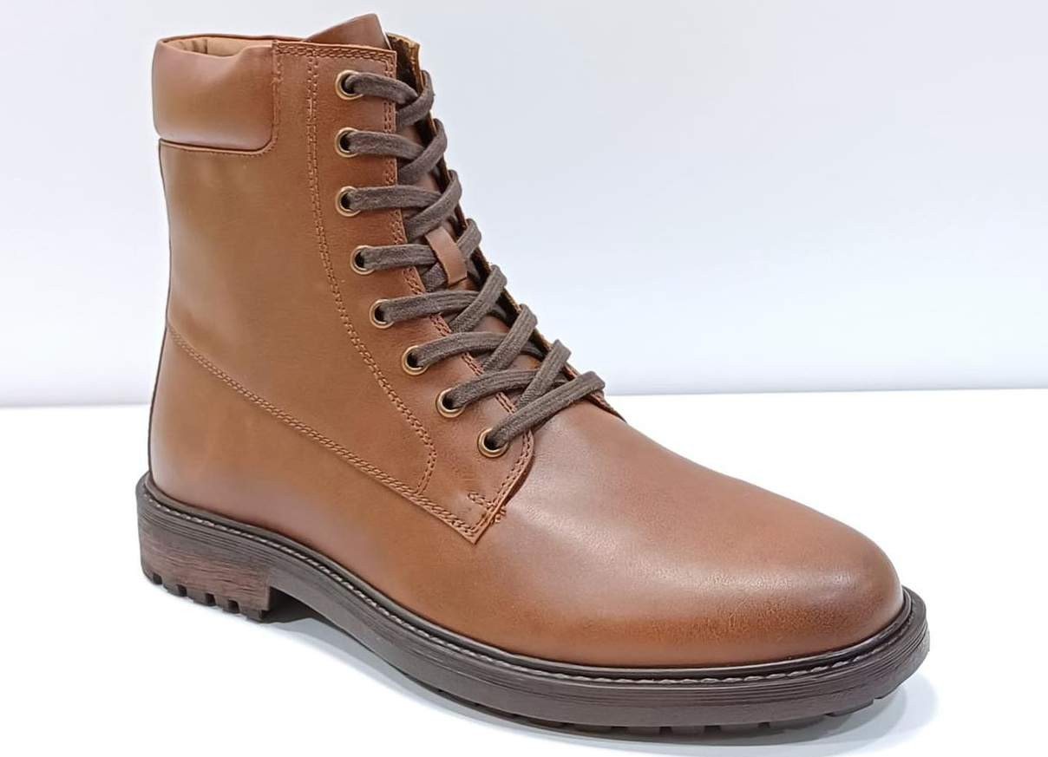
Model | LMM-10012
L E M A K E X P O R T S P V T
Factory - 1
64-B1 Co-operative Industrial Area Dada Nagar, Kanpur 208022 kushal@lemakexports.com
L T D

Slide 5
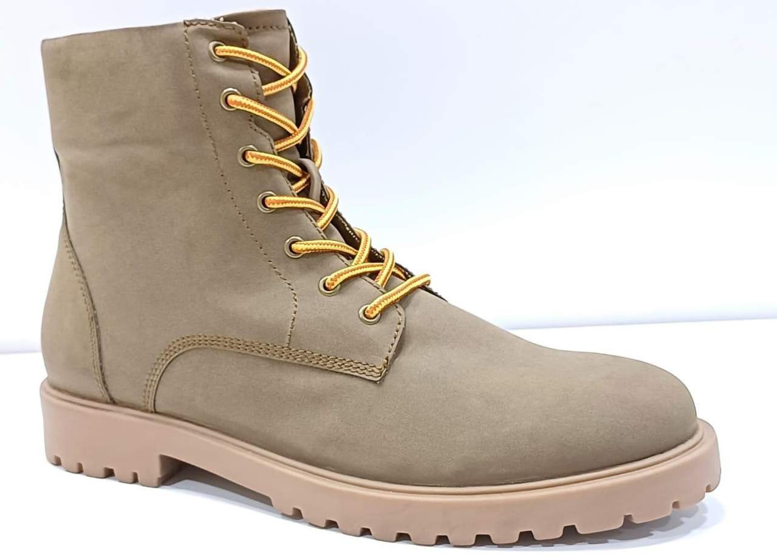
Model | LMM-10013
L E M A K E X P O R T S P V T
Factory - 1
64-B1 Co-operative Industrial Area Dada Nagar, Kanpur 208022 kushal@lemakexports.com
L T D

Slide 6
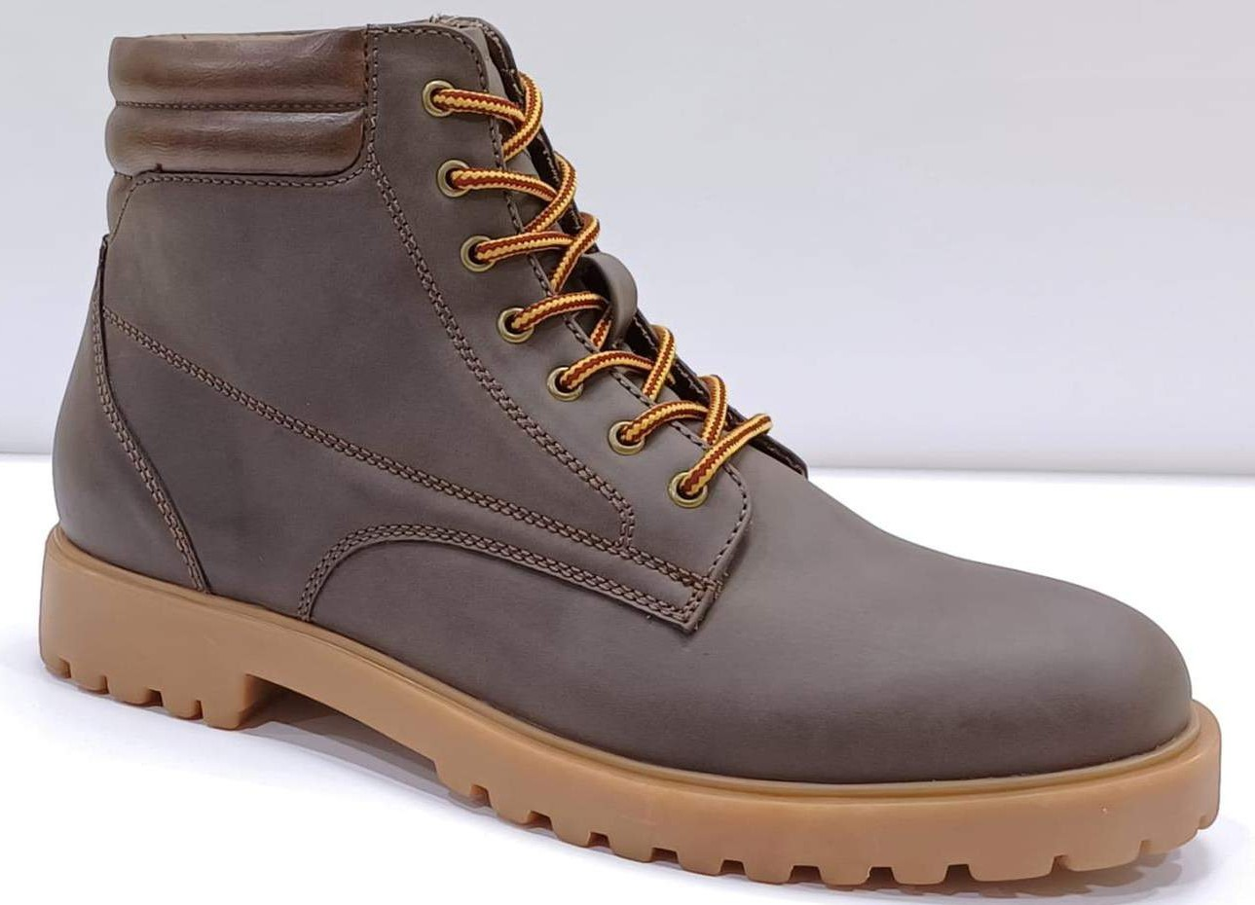
Model | LMM-10014
L E M A K E X P O R T S P V T
Factory - 1
64-B1 Co-operative Industrial Area Dada Nagar, Kanpur 208022 kushal@lemakexports.com
L T D

Slide 7
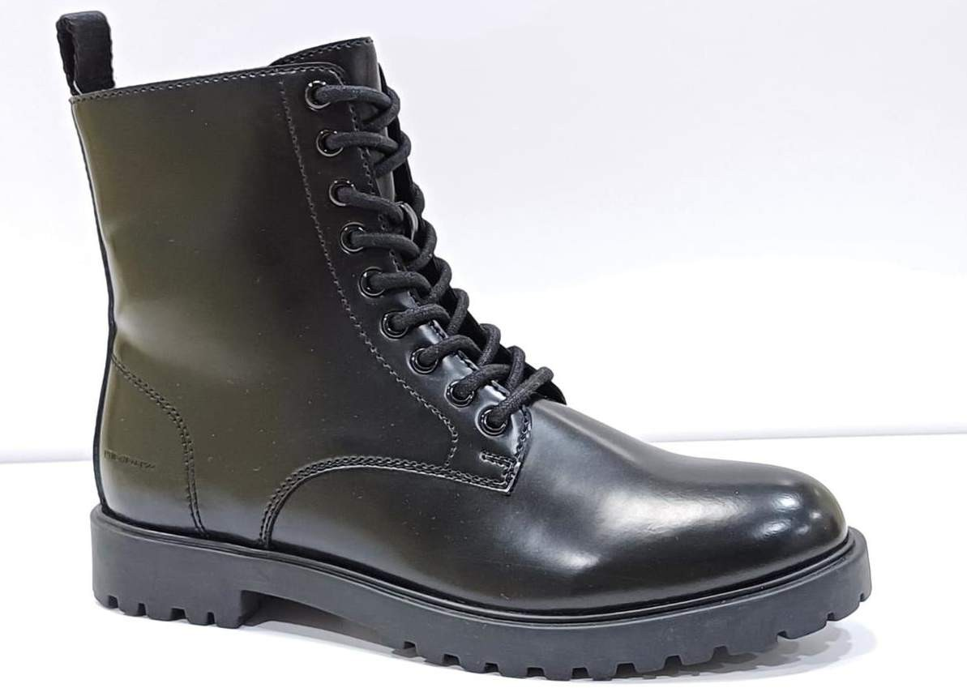
Model | LMM-10015
L E M A K E X P O R T S P V T
Factory - 1
64-B1 Co-operative Industrial Area Dada Nagar, Kanpur 208022 kushal@lemakexports.com
L T D

Slide 8
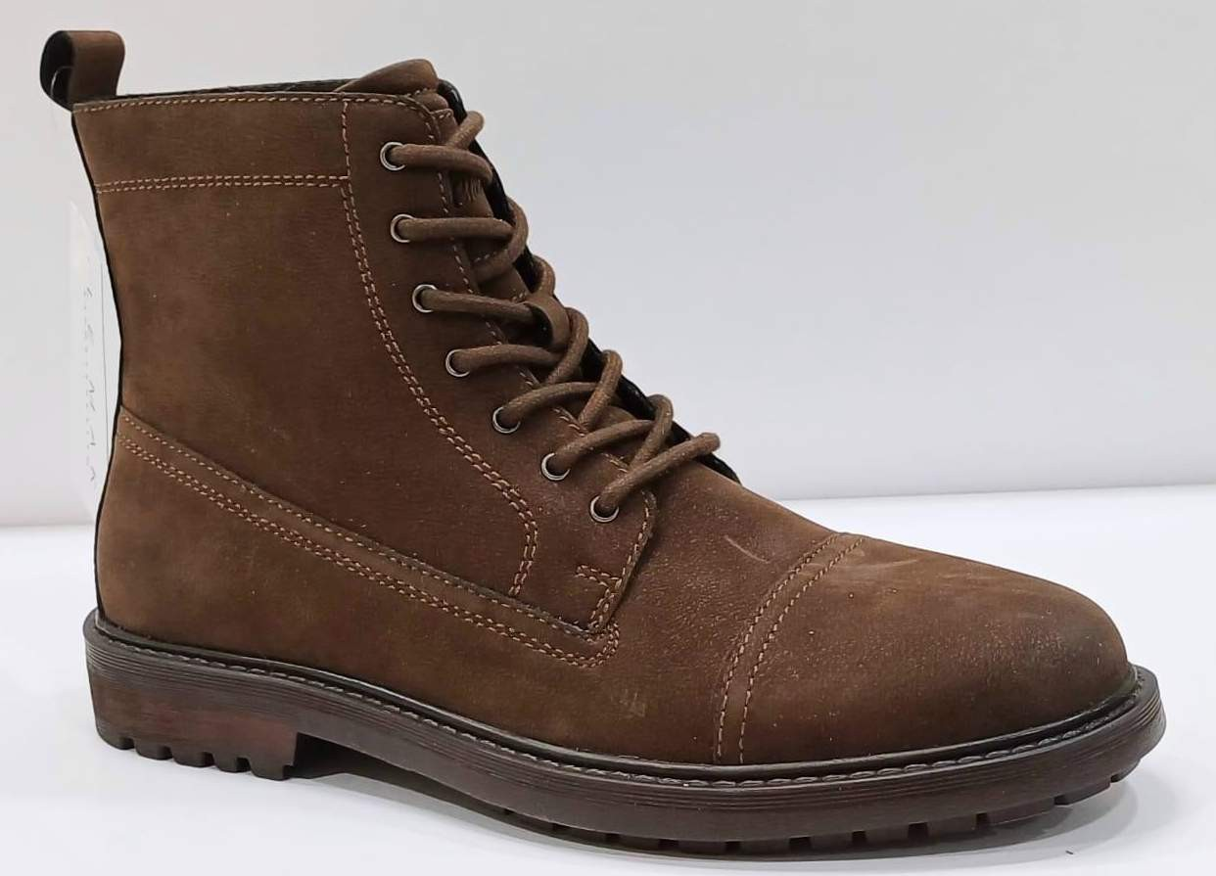
Model | LMM-10016
L E M A K E X P O R T S P V T
Factory - 1
64-B1 Co-operative Industrial Area Dada Nagar, Kanpur 208022 kushal@lemakexports.com
L T D

Slide 9
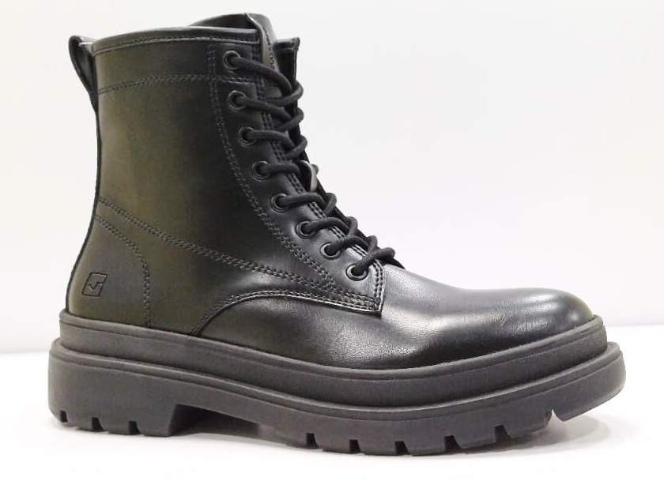
Model | LMM-10017
L E M A K E X P O R T S P V T
Factory - 1
64-B1 Co-operative Industrial Area Dada Nagar, Kanpur 208022 kushal@lemakexports.com
L T D

Slide 10
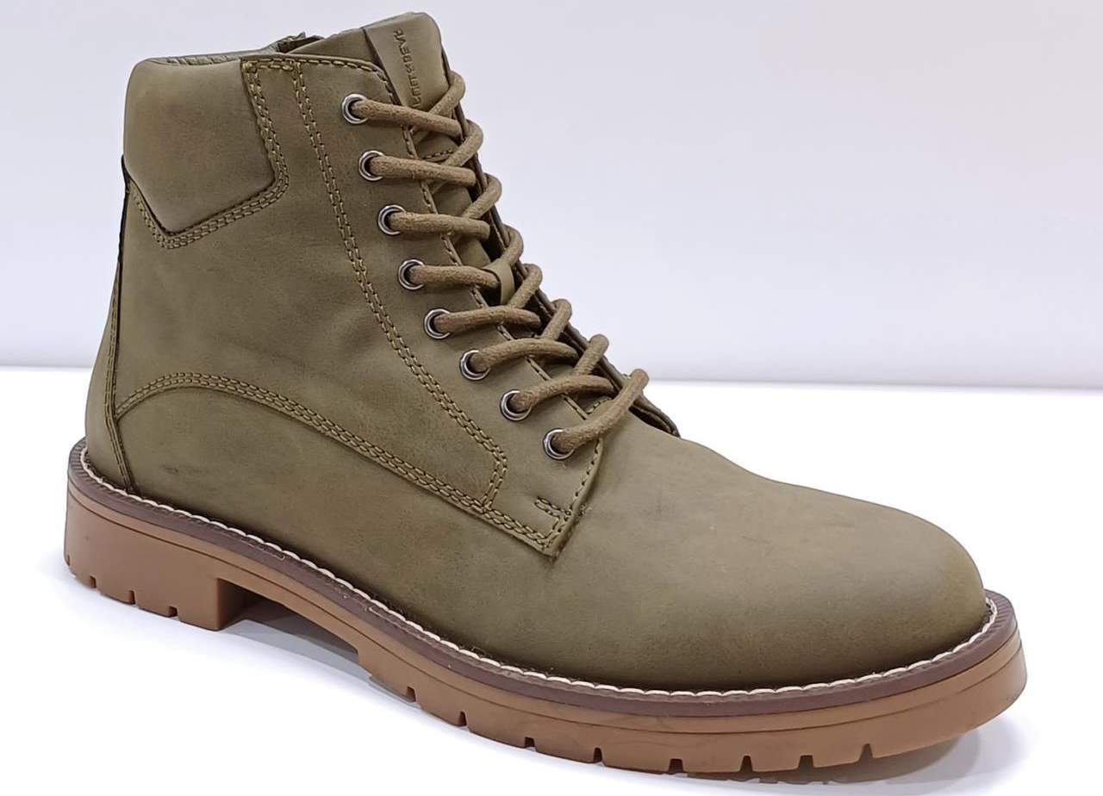
Model | LMM-10018
L E M A K E X P O R T S P V T
Factory - 1
64-B1 Co-operative Industrial Area Dada Nagar, Kanpur 208022 kushal@lemakexports.com
L T D

Slide 11
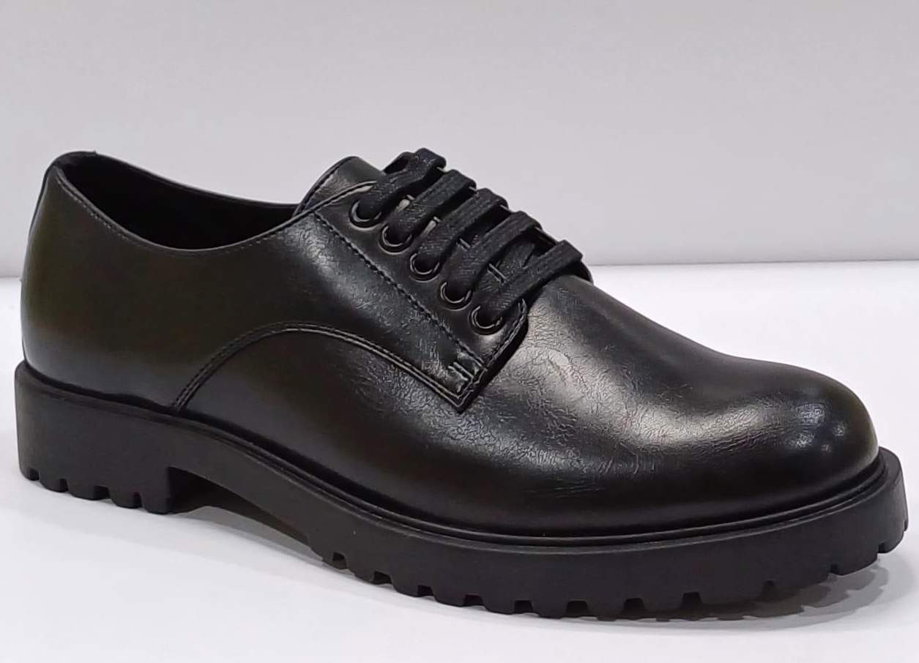
Model | LMM-10019
L E M A K E X P O R T S P V T
Factory - 1
64-B1 Co-operative Industrial Area Dada Nagar, Kanpur 208022 kushal@lemakexports.com
L T D

Slide 12
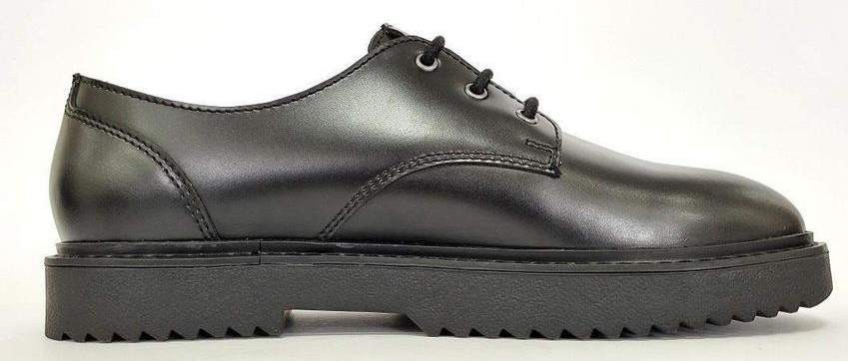
Model | LMM-10020
L E M A K E X P O R T S P V T
Factory - 1
64-B1 Co-operative Industrial Area Dada Nagar, Kanpur 208022 kushal@lemakexports.com
L T D

Slide 13
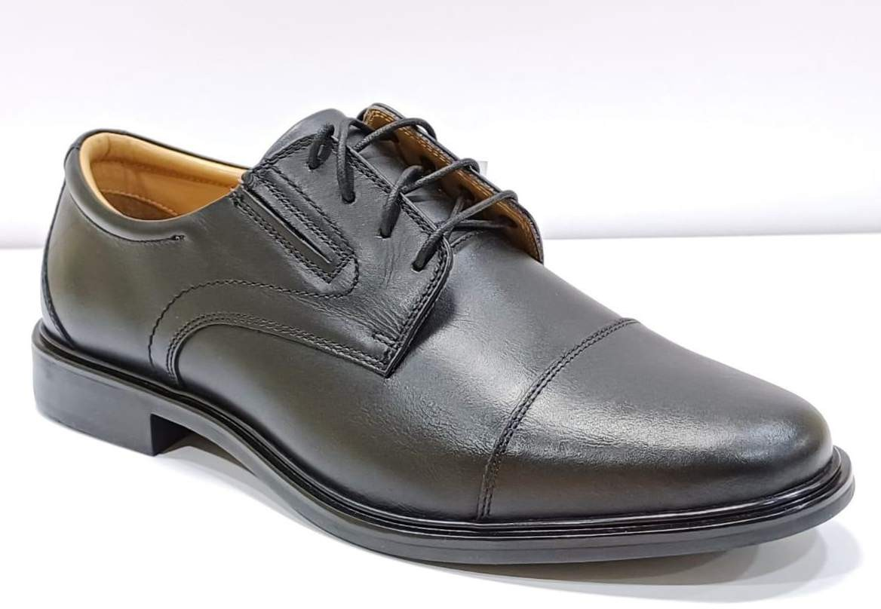
Model | LMM-21005
L E M A K E X P O R T S P V T
Factory - 1
64-B1 Co-operative Industrial Area Dada Nagar, Kanpur 208022 kushal@lemakexports.com
L T D

Slide 14
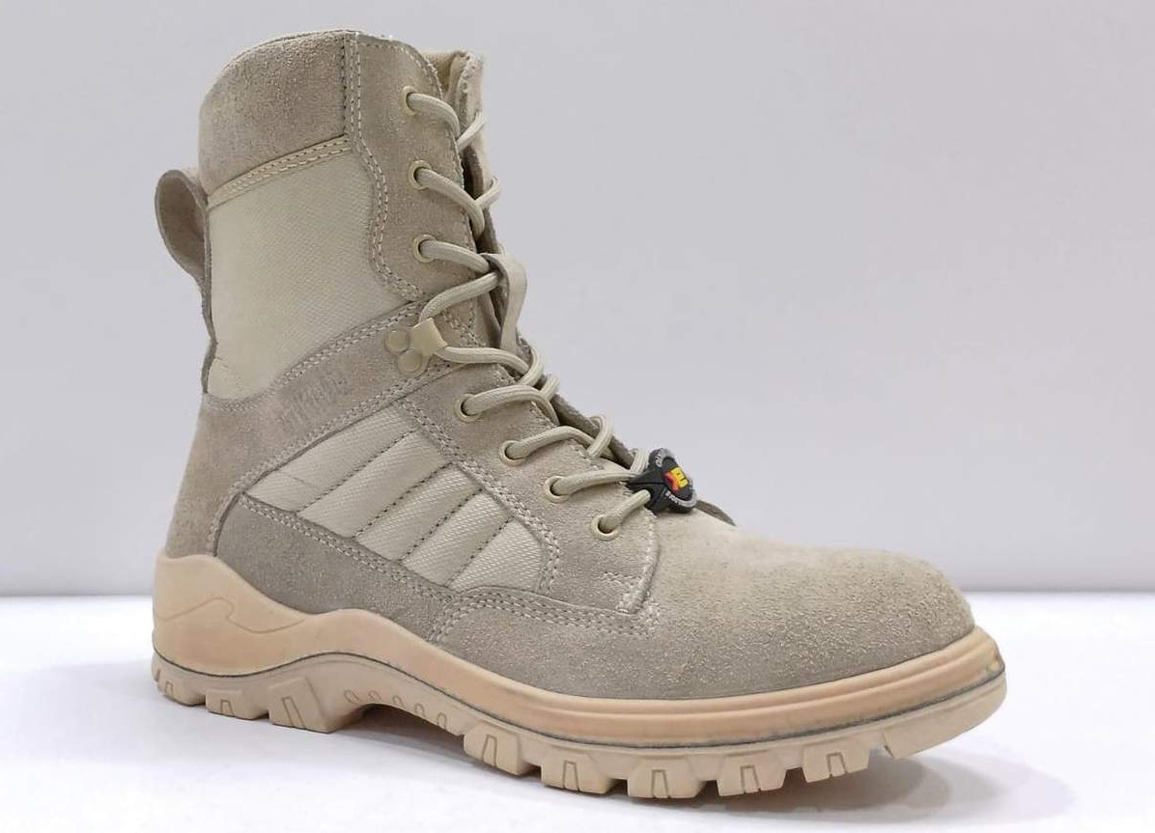
Model | LMM-20010
L E M A K E X P O R T S P V T
Factory - 1
64-B1 Co-operative Industrial Area Dada Nagar, Kanpur 208022 kushal@lemakexports.com
L T D

Slide 15
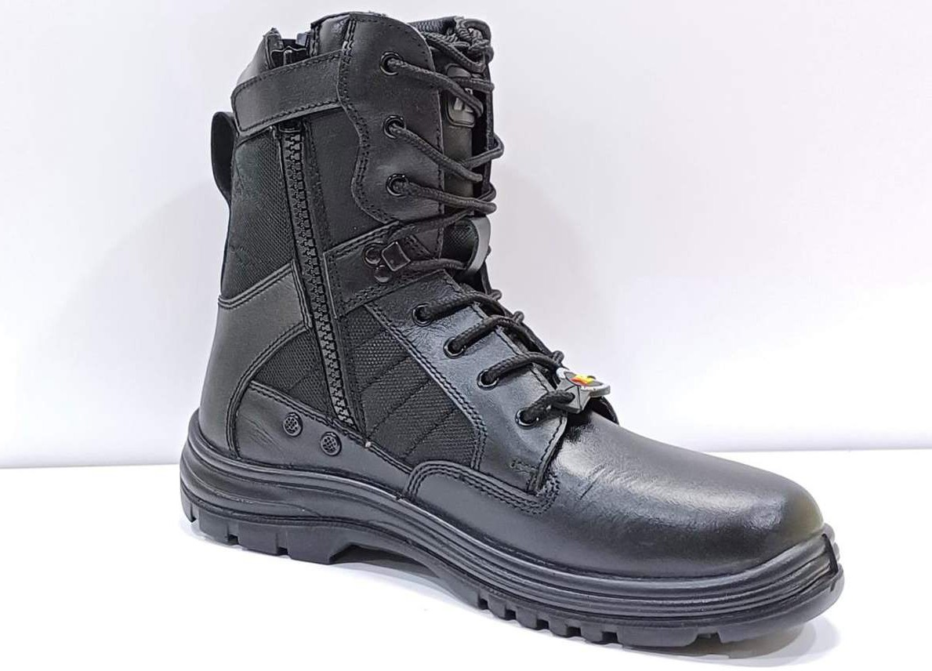
Model | LMM-20011
L E M A K E X P O R T S P V T
Factory - 1
64-B1 Co-operative Industrial Area Dada Nagar, Kanpur 208022 kushal@lemakexports.com
L T D

Slide 16
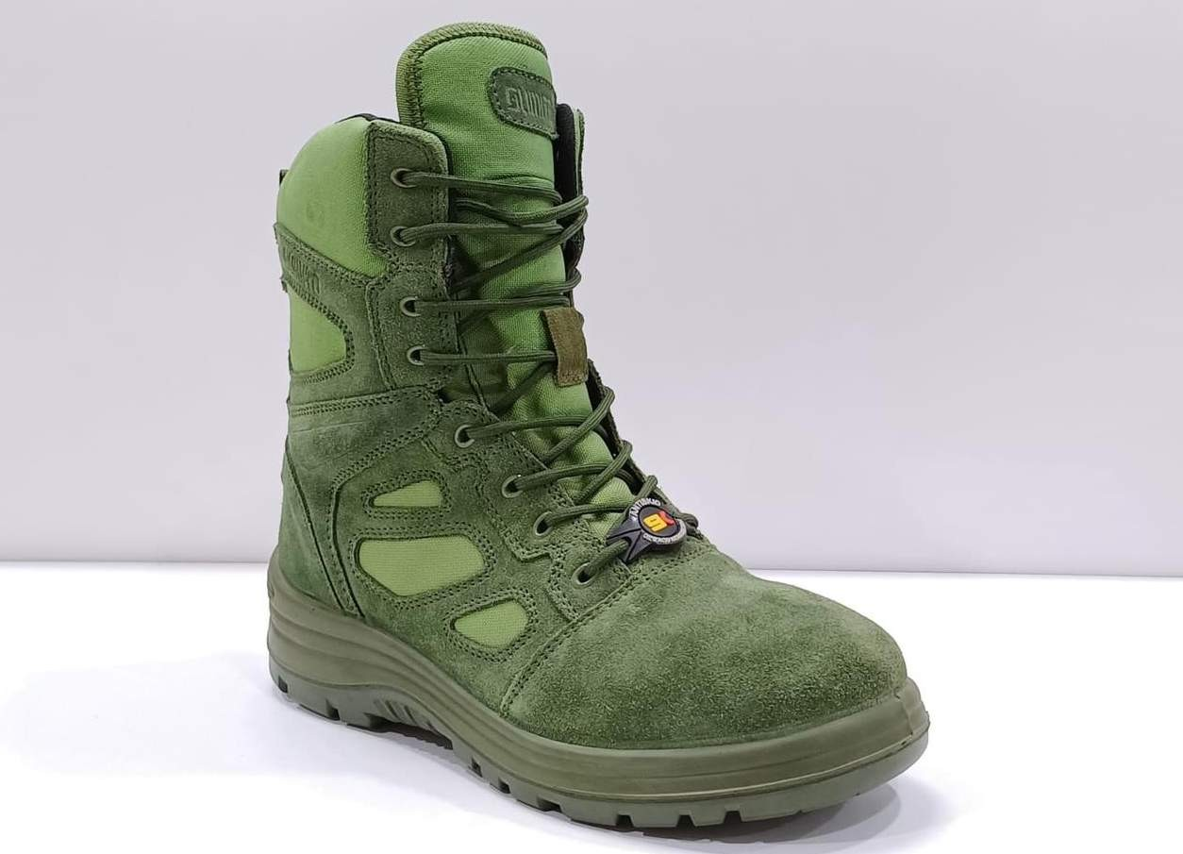
Model | LMM-20012
L E M A K E X P O R T S P V T
Factory - 1
64-B1 Co-operative Industrial Area Dada Nagar, Kanpur 208022 kushal@lemakexports.com
L T D

Slide 17
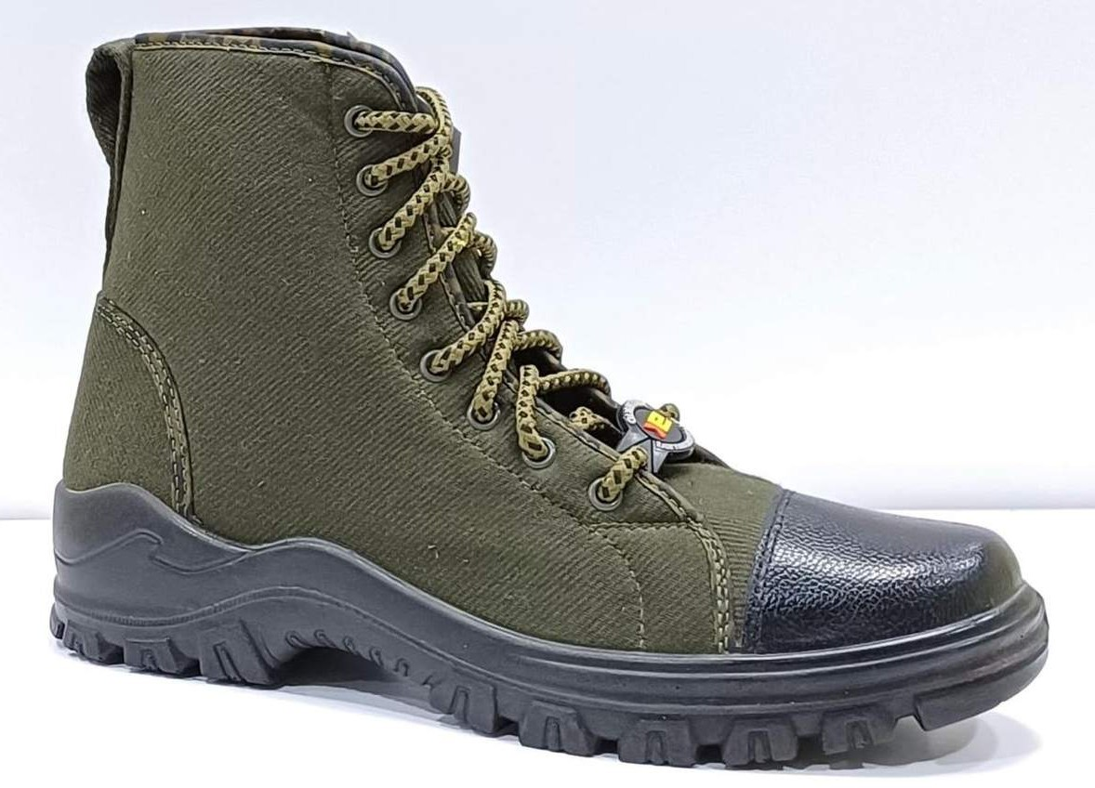
Model | LMM-20013
L E M A K E X P O R T S P V T
Factory - 1
64-B1 Co-operative Industrial Area Dada Nagar, Kanpur 208022 kushal@lemakexports.com
L T D

Slide 18
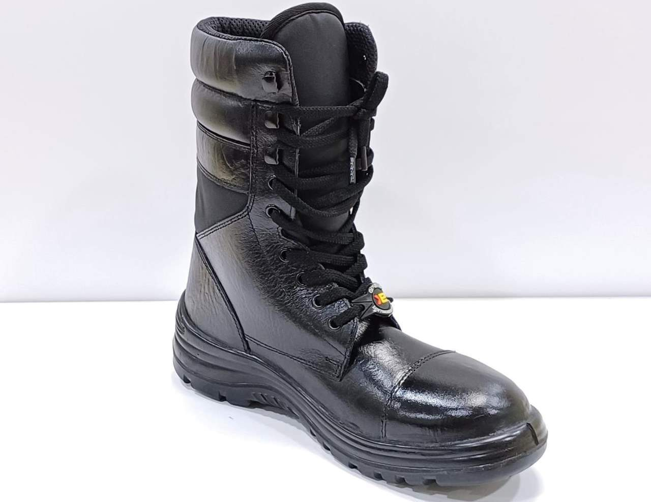
Model | LMM-21005
L E M A K E X P O R T S P V T
Factory - 1
64-B1 Co-operative Industrial Area Dada Nagar, Kanpur 208022 kushal@lemakexports.com
L T D

Slide 19
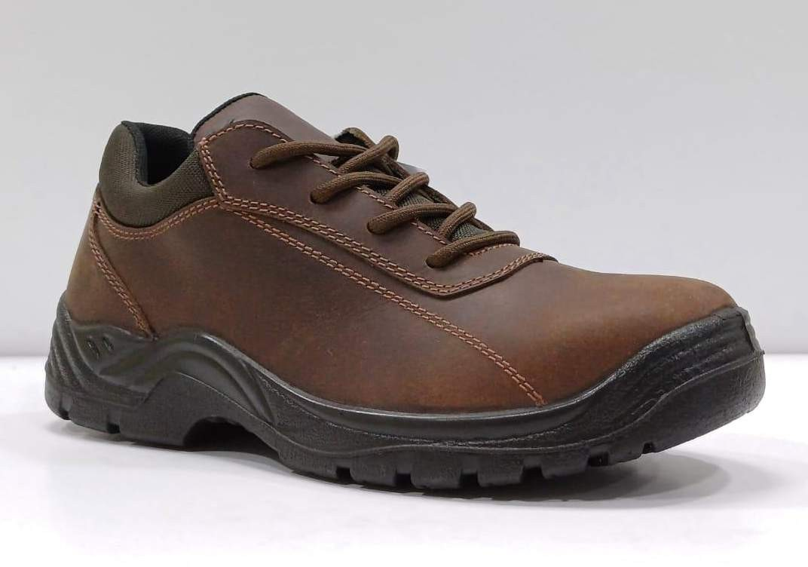
Model | LMM-20014
L E M A K E X P O R T S P V T
Factory - 1
64-B1 Co-operative Industrial Area Dada Nagar, Kanpur 208022 kushal@lemakexports.com
L T D

Slide 20
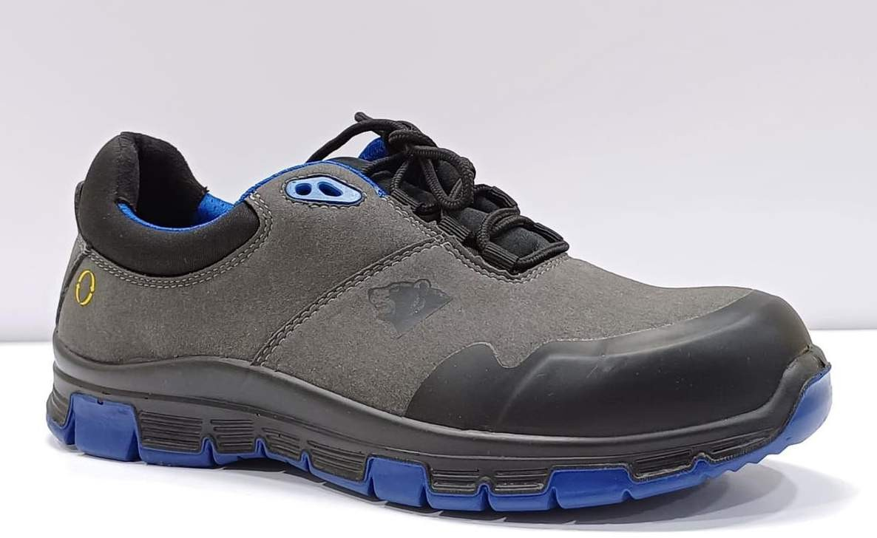
Model | LMM-20015
L E M A K E X P O R T S P V T
Factory - 1
64-B1 Co-operative Industrial Area Dada Nagar, Kanpur 208022 kushal@lemakexports.com
L T D

Slide 21
Rajesh Tandon.
LE MAK EXPORTS PVT LTD.
Address:
64-B1 Co-Operative Industrial Area Dada Nagar, Kanpur
208022, India
rajesh@lemakexports.com
+91-7081 593 999 / +91-945 2281 761(WhatsApp)
+91-512-222-0006
+91-512-223-0006
Plot no. 448,449 & 657, Sachendi Pargana, Chakarpur,
email:
Mob: Phone: Fax:
Factory:
Kanpur Nagar-209304, Uttar Pradesh, India
L E M A K E X P O R T S P V T
Factory - 1
64-B1 Co-operative Industrial Area Dada Nagar, Kanpur 208022 kushal@lemakexports.com
L T D

